Slide 1
Smart Agriculture system based on IoT
By:- Kaushal batra
Project ID: SPS_PRO_101
Title: Smart Agriculture system based on IoT - SB45404

Slide 2
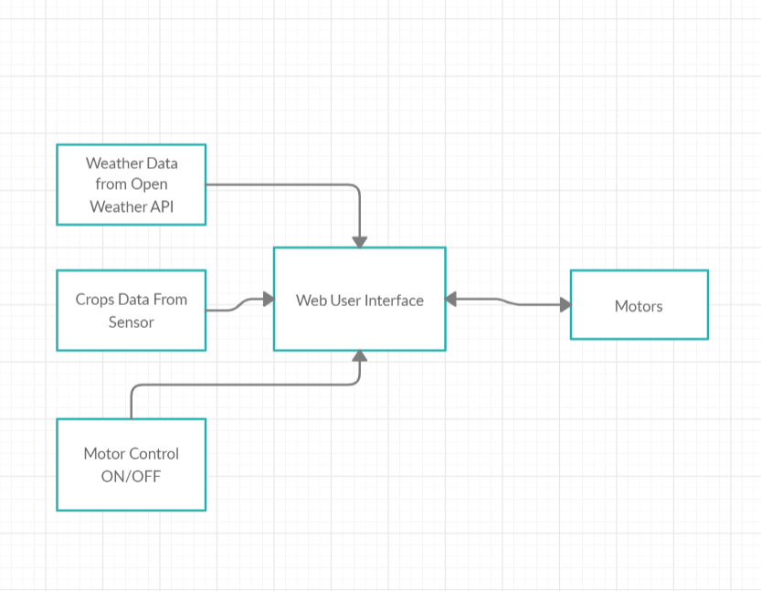
Theory Block Diagram :

Slide 3
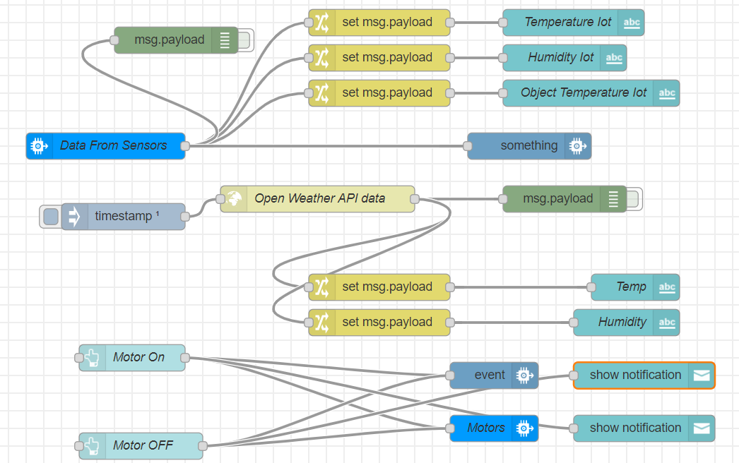
Software Design

Slide 4
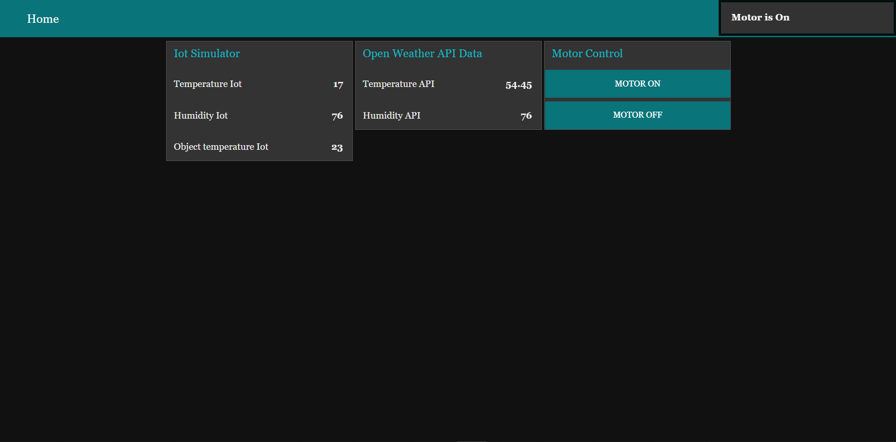
Web User Interface

Slide 5


